Slide 1
BMI Calc

Slide 2
PROBLEM
Many students are still relying on traditional methods, such as pen, paper, and calculators, for computing BMI

Slide 3
SOLUTION
Digitalize the BMI calculator so that students only need to input their data, and it will automatically determine whether they're underweight, healthy, or overweight.
TITLE
BMICalC

Slide 4
PEOPLE(USERS)
Student - Elementary to College (Any student undergoing a PE subject)
GYM goers
Employees –Any employee who wants to track their BMI.

Slide 5
ACTIVITIES(FEATURE)
CONTEXT (INTERACTION / REQUIRMENT ANALYSIS):
An app that can calculate BMI based on the inputted data and track the records.
Flexible for any screen type
Using local storage as backend

Slide 6
TECHNOLOGY
Easy to Navigate
very simple to use
User friendly UI
Flutter Framework
Dart
Flutter Hive

Slide 7
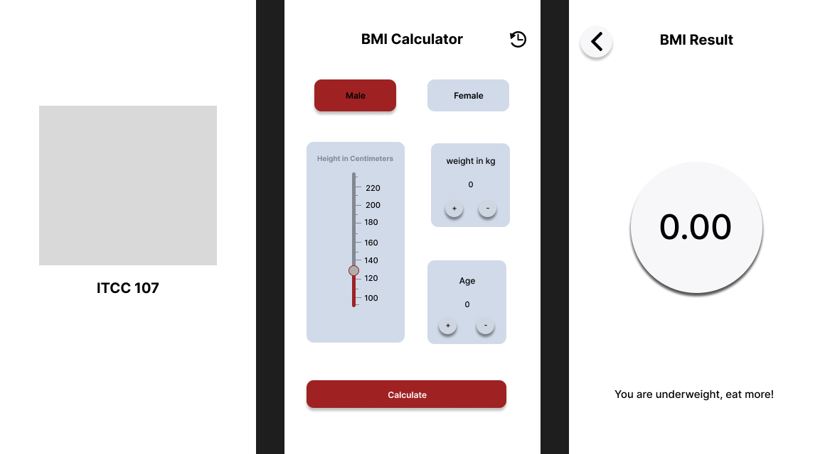
FIGMA DESIGN

Slide 8
Thank you

